Slide 1
Lending Club Case Study
Avinash Kumar, Krishna Mojamdar

Slide 2
Objective
The aim of this case study is to get an idea of how real-world business problems are solved using EDA.
1
Applying different EDA techniques
2
Develop an understanding of risk analytics in the BFSI domain
3
How the data is used to minimize loss of money while lending to customers.

Slide 3
Business Understanding
When the company receives a loan application, the company must decide for loan approval based on the applicant’s profile.
The data given contains the information about past loan applicants and whether they ‘defaulted’ or not. The aim is to identify patterns which indicate if a person is likely to default, which may be used for taking actions such as denying the loan, reducing the amount of loan, lending (to risky applicants) at a higher interest rate, etc.
There are two types of risks associated with the bank’s decision:
If the applicant is likely to repay the loan, then not approving the loan results in a loss of business to the company
If the applicant is not likely to repay the loan, i.e. he/she is likely to default, then approving the loan may lead to a financial loss for the company

Slide 4
Types of decisions
Loan Accepted
Fully Paid
Charged Off
Loan Rejected
Not Considered and not part of the dataset
Current

Slide 5
Loan Accepted
Fully Paid
Applicant has fully paid the loan (the principal and the interest rate)
Current
Applicant is in the process of paying the instalments, i.e. the tenure of the loan is not yet completed. These candidates are not labelled as 'defaulted'.
Charged-off
Applicant has not paid the instalments in due time for a long period of time, i.e. he/she has defaulted on the loan

Slide 6
Data Cleanup
The following steps were taken to clean up the data and make it ready for EDA.
Import
Fix Rows and Columns
Impute Missing Values
Fix and Derive Values
Fix Data types
Filter Data

Slide 7
Exploratory Data Analysis
Performed
Univariate Analysis
Performed
Segmented Univariate Analysis
Performed
Bivariate Analysis

Slide 8

Univariate Analysis
Analysis of singe variables.
Does not involve relationship with any other variable
Descriptive in nature

Slide 9
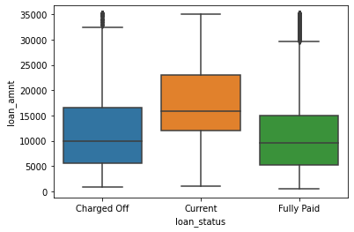
Loan Status
The loan amount ranges from 0 to 35000 with the mean being an amount of 10000.
There are a few outliers.
Outliers above 29250 were removed from the dataset

Slide 10
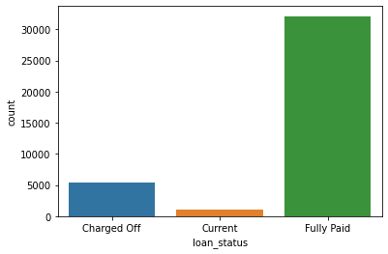
Loan Status
Majority of the loans have been fully paid.
There are a few which have been charged off.

Slide 11
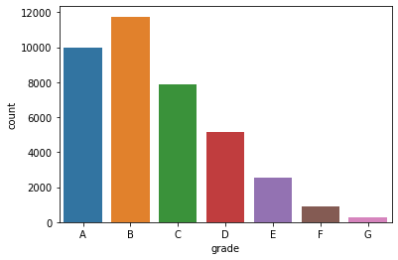
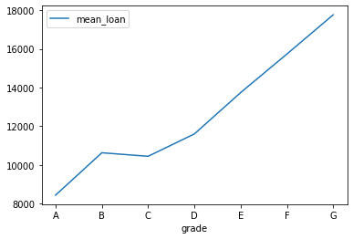
Loan Grade
Grade A is basic loan and Grade G is premium loan
Most of the loans fall under grade A and B. Hence most of the loans are low graded loans.
Note: It's assumed that Grade G is the highest based on the mean of loans.

Slide 12
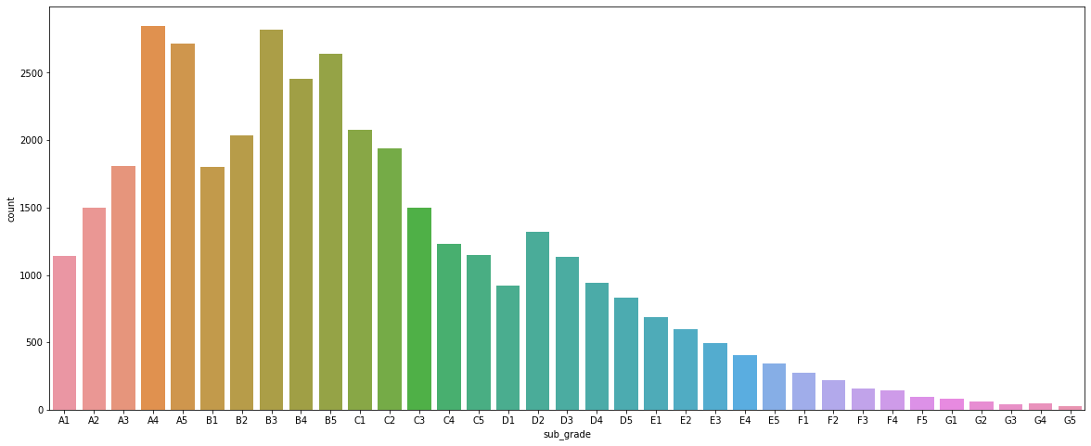
Loan Grade
Majority of the loan fall under sub grade A4 to B5

Slide 13
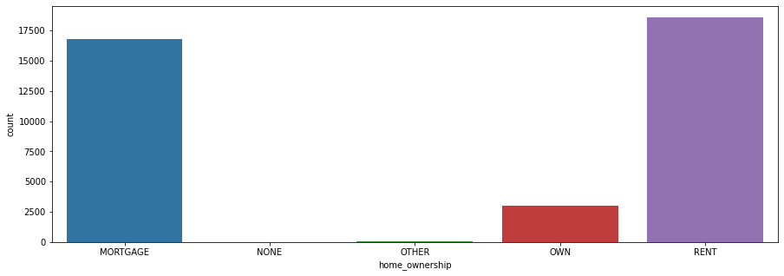
Home Ownership
A high number of the applicants live in rented and mortgaged houses.
Very few of the customers own a house.

Slide 14
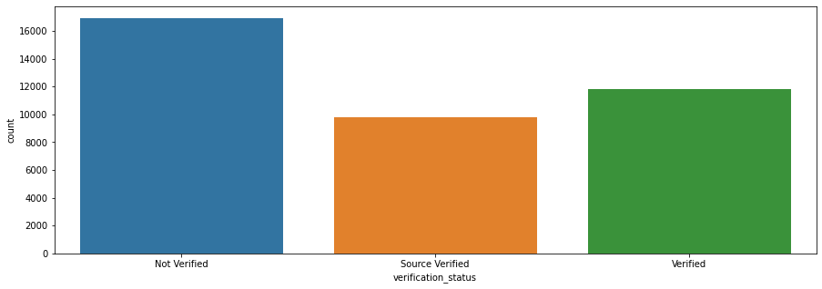
Verification Status
A large number of customers were totally not verified

Slide 15
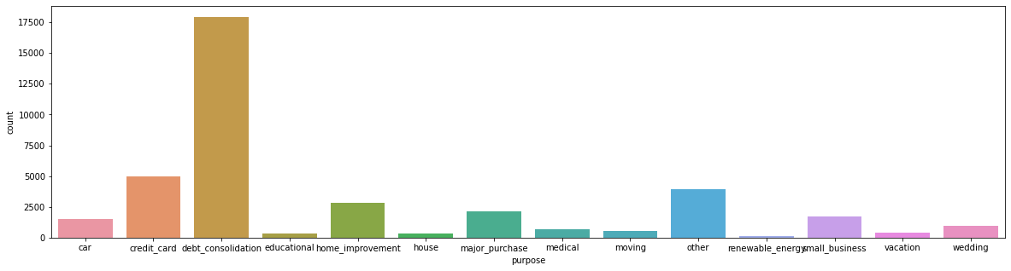
Purpose of loan
Debt consolidation seems to be the major purpose of taking a loan.

Slide 16
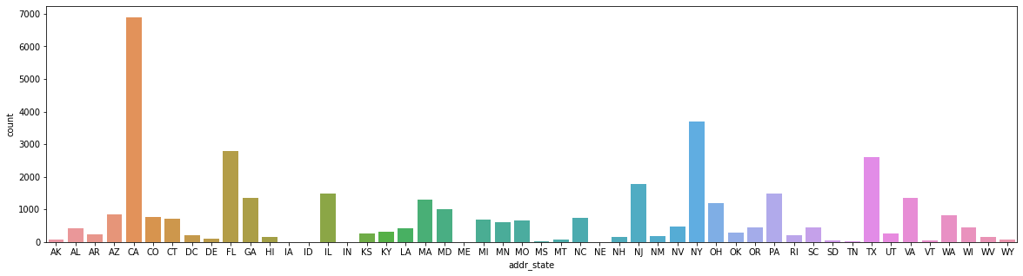
State Wise
A large number of loans were granted in CA followed by NY and TX.

Slide 17
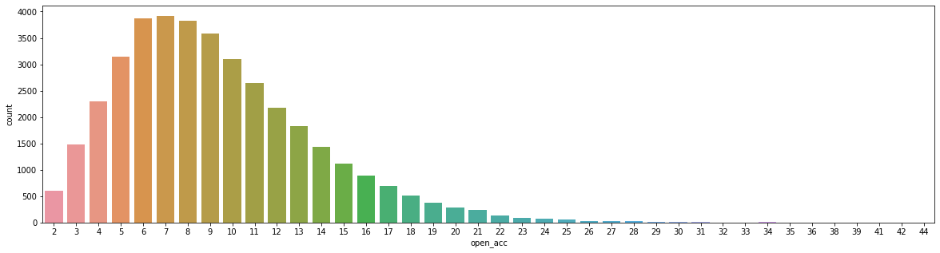
Credit Line
A majority of customers have more than 5 credit lines with the highest being in the range 5-11.

Slide 18
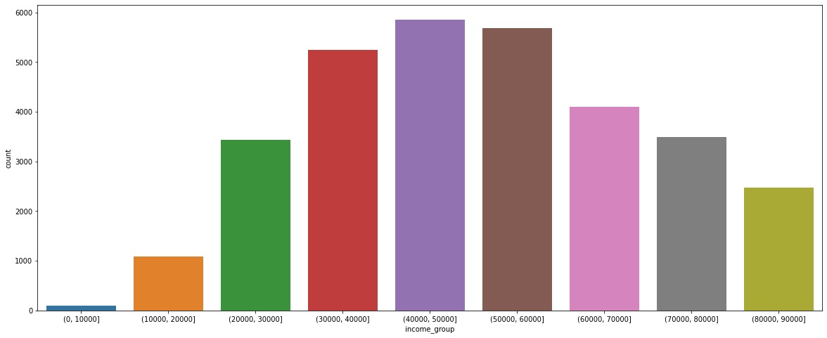
Income Groups
Income group 40000-60000 has the highest number of applicants in the dataset.

Slide 19
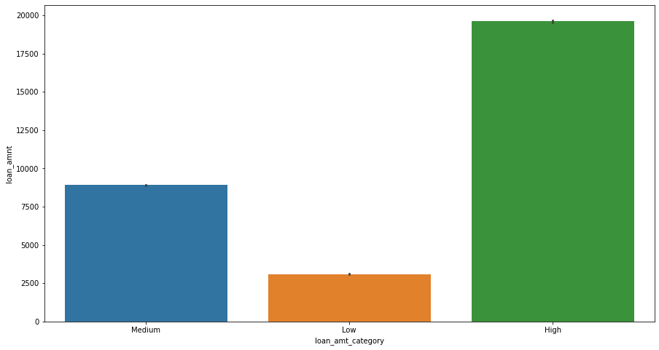
Loan Amount Category
Majority of the loans are in the High Category where amount is greater than 15000.
Range of the Buckets
Low < 5000
Medium – 5000 to 15000
High > 15000

Slide 20
Segmented Univariate Analysis
Analysis of singe variables.
Does not involve relationship with any other variable
Descriptive in nature
Dataset is analyzed in subsets.

Slide 21
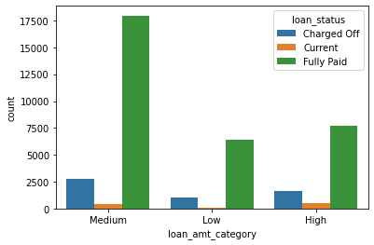
Loan Category vs Loan Status
It's noted that there is a high Charge off for loans falling under Medium Loan Category i.e Above 5000 and Under 15000.

Slide 22
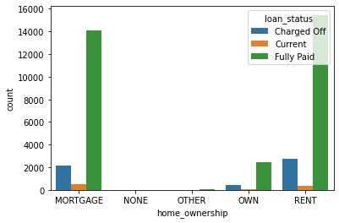
Home Ownership vs Loan Status
Applicants on Mortgage and Rent have the highest Charge off.
It appears that homeowners also default on loan repayment and are charged off however the number seems to be quite low.

Slide 23
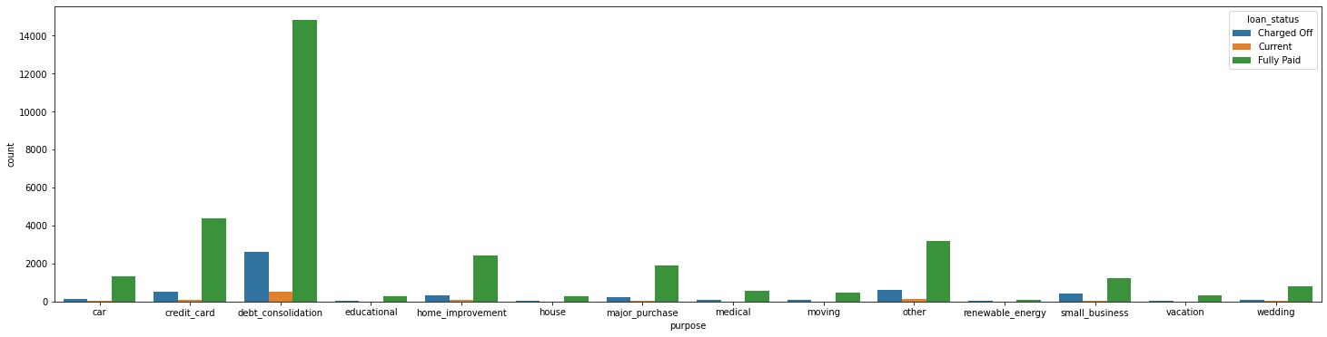
Loan Status vs Purpose
It can be observed that even though debt consolidation has the highest fully paid applicants, it also has the highest charge offs.

Slide 24
Bivariate Analysis
Analysis of two or more variables.
Includes relationship with other variable

Slide 25
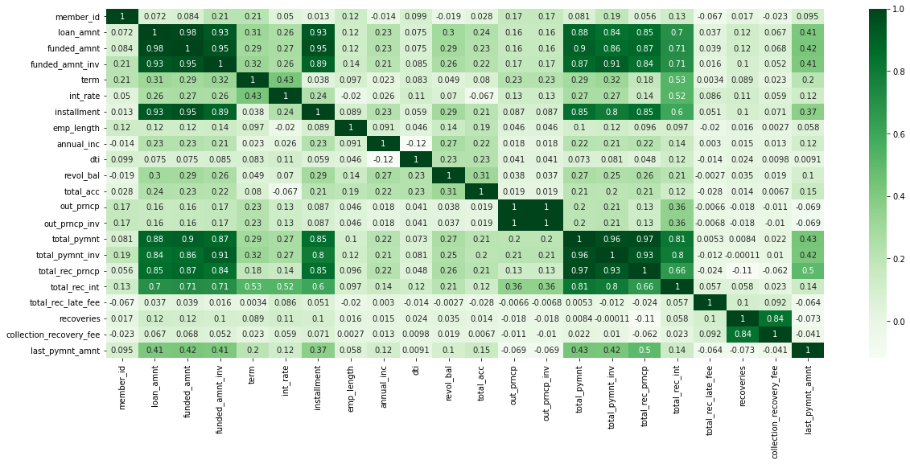
Correlation Heatmap

Slide 26
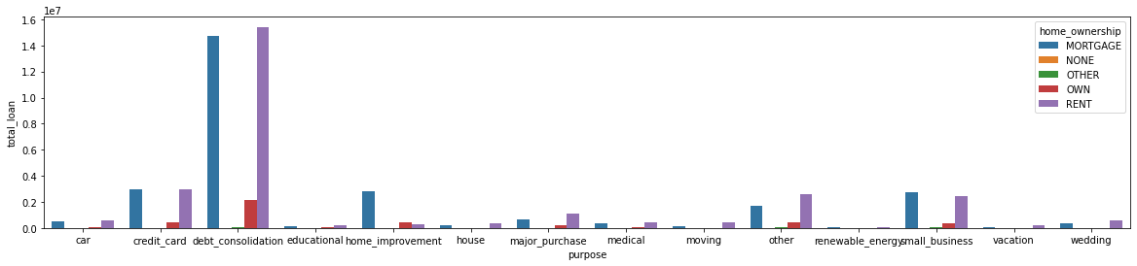
Purpose Vs Homeownership
A huge spike is observed in the total loans that have been waivered is for people who do not own a house and borrowed money for debt consolidation

Slide 27
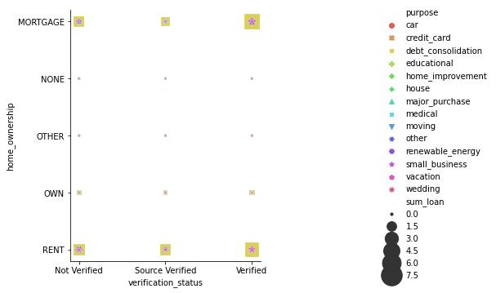
Homeownership Vs Verification and Purpose
A high amount of loan is being charged off from customers who are verified and have either mortgaged their home or customers who stay in rented homes. The same is true for customers who take loans for debt consolidation.
Note: The size of the points on the plot are proportional to the total sum of the loan and relative to the purpose for which the loan was taken. Each shape and color represent various purposes as can be seen in the legend.

Slide 28
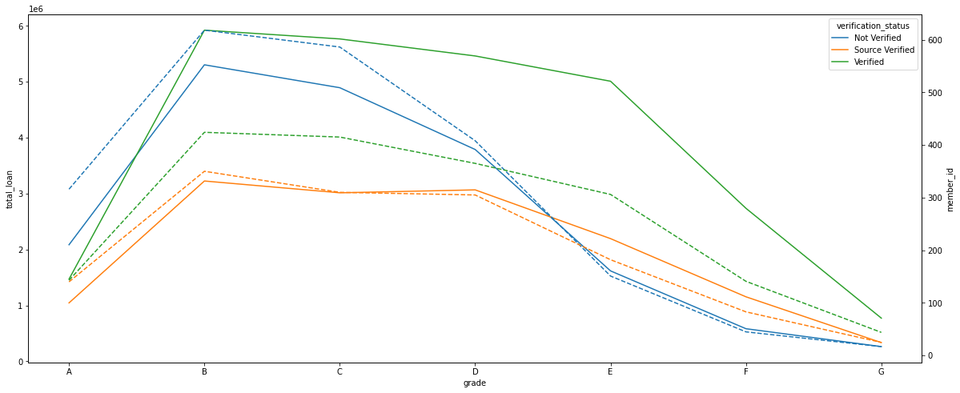
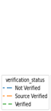
Grade Vs Verification
The total amount of charged off loans are for grade B and grade C given to Verified sources
* Dashed Lines represent the number of people who taking the loans
Solid lines is sum of the total loan amount

Slide 29
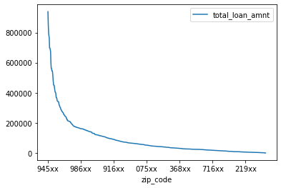
Zip Code and Total Sum of Loan Amount
A huge spike is observed for people who reside in the zip code "945xx“.

Slide 30
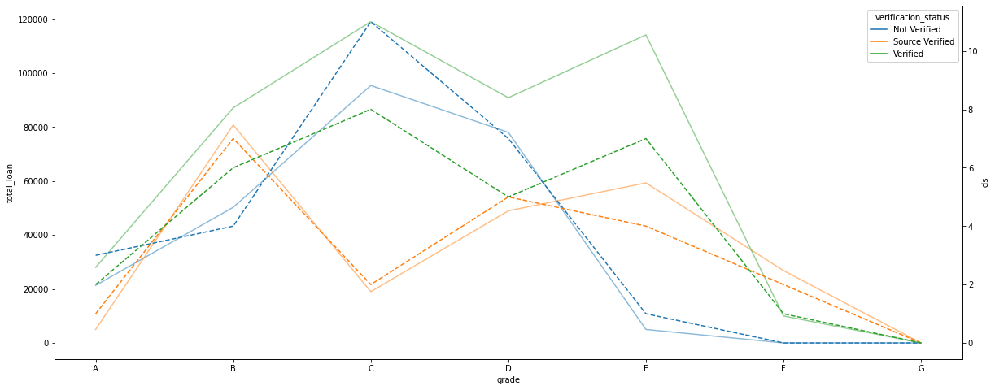
Loans in Zip 945xx vs Sum(Loan Amt) and Verification Status
Contrary to what was observed in the overall trend, the most charged off loans for zip code 945xx was for grade C and grade E. Grade G loans were not granted to people residing in this zip code

Slide 31
Summary (1/3)
The loan amount ranges from 0 to 35000 with the mean being an amount of 10000. The dataset had a few outliers and any amount above 29250 was considered to be the outlier and removed from the dataset under consideration to get an even distribution.
It was observed that a majority of the loans have been fully paid and a substantial number were charged off.
The dataset offered grades (A to G) for each loan with G being the premium loans (High loan amount).
Given the fact, it was observed that most of the loans fall under grade A, B and Sub Grade A4 to B5. Hence most of the loans are low graded loans i.e Low loan amount.

Slide 32
Summary (2/3)
A quick analysis of the identified data suggested the following:
Grade B has the highest number of applicants
A high number of the applicants live in rented and mortgaged houses. A few own a house.
Majority of the loans are fully paid.
Debt consolidation seems to be the major purpose of taking a loan.
More than 20000 of the applicants had credit inquires over the last 6 months.
A large population has more than 3 open credit lines
Income group 40000-60000 has the highest number of applicants in the dataset.
Majority of the loans are in the High category.
It was noted that there is a high Charge off for loans falling under Medium Loan Category
Applicants on Mortgage and Rent have the highest Charge off.

Slide 33
Summary (3/3)
B grade loans tend to be charged off for verified sources
California (CA) has the highest number of applicants.
A huge spike is observed for people who reside in the zip code "945xx“

Slide 34
Conclusion
A huge spike was observed in the total loans that have been waivered is for people who have who do not own a house and borrowed money for debt consolidation and a high amount of loan is being charged off from customers who are verified and have either mortgaged their home or customers who stay in rented homes. The same is true for customers who take loans for debt consolidation.
Contrary to what was observed in the overall trend, the most charged off loans for zip code 945xx was for grade C and grade E. Grade G loans were not granted to people residing in this zip code

